Slide 1
Design for Testability Theory and Practice
Lecture 6: Combinational ATPG
ATPG problem
Example
Algorithms
  Multi-valued algebra
  D-algorithm
  Podem
  Other algorithms
ATPG system
Summary

Slide 2
ATPG Problem
ATPG: Automatic test pattern generation
  Given
    A circuit (usually at gate-level)
    A fault model (usually stuck-at type)
  Find
    A set of input vectors to detect all modeled faults.
Core solution: Find a test vector for a given fault.
Combine the “core solution” with a fault simulator into an ATPG system.

Slide 3
What is a Test?
Fault activation
Fault effect
X
1
0
0
1
0
1
X
X
Combinational circuit
1/0
1/0
Primary inputs
(PI)
Primary outputs
(PO)
Path sensitization
Stuck-at-0 fault

Slide 4
Multiple-Valued Algebras
Symbol
D
D
0
1
X
G0
G1
F0
F1
Alternative
Representation
1/0
0/1
0/0
1/1
X/X
0/X
1/X
X/0
X/1
Fault-free
circuit
1
0
0
1
X
0
1
X
X
Faulty
Circuit
0
1
0
1
X
X
X
0
1
Roth’s
Algebra
Muth’s
Additions

Slide 5
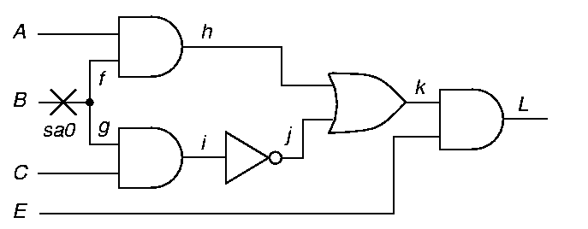
An ATPG Example
Fault activation
Path sensitization
Line justification
1
D

Slide 6
ATPG Example (Cont.)
Fault activation
Path sensitization
Line justification
1
D
D
1
D
D
0
1

Slide 7
ATPG Example (Cont.)
Fault activation
Path sensitization
Line justification
1
D
D
1
D
Conflict
0
D
1
1
1
1

Slide 8
ATPG Example (Cont.)
Fault activation
Path sensitization
Line justification
Backtrack
0
D
1
D
D
1
D
1
D

Slide 9
ATPG Example (Cont.)
Fault activation
Path sensitization
Line justification
0
0
D
1
D
D
1
D
1
D
1
Test found

Slide 10
D-Algorithm (Roth 1967)
Use D-algebra
Activate fault
    Place a D or D at fault site
    Justify all signals
Repeatedly propagate D-chain toward POs through a gate
    Justify all signals
Backtrack if
    A conflict occurs, or
    All D-chains die
Stop when
    D or D at a PO, i.e., test found, or
    Search exhausted, no test possible

Slide 11
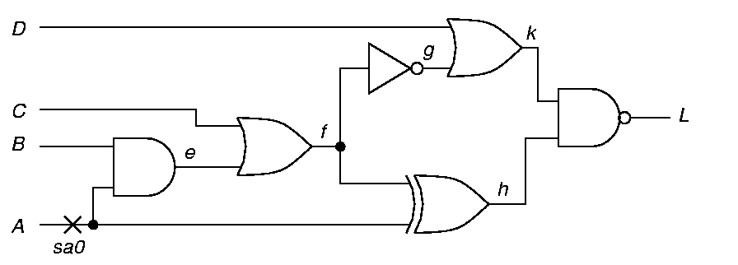
Example: Fault A sa0
Step 1 – Fault activation – Set A = 1
D
1
D
D-frontier = {e, h}

Slide 12
Example Continued
Step 2 – D-Drive – Set f = 0
0
D
1
D
D

Slide 13
Example Continued
Step 3 – D-Drive – Set k = 1
1
D
0
D
1
D
D

Slide 14
Example Continued
Step 4 – Consistency – Set g = 1
1
1
D
0
D
1
D
D

Slide 15
Example Continued
Step 5 – Consistency – f = 0 Already set
1
1
D
0
D
1
D
D

Slide 16
Example Continued
Step 6 – Consistency – Set c = 0, Set e = 0
1
0
1
D
0
0
D
1
D
D

Slide 17
Example: Test Found
Step 7 – Consistency – Set B = 0
Test: A = 1, B = 0, C = 0, D = X
X
1
0
1
D
0
0
0
D
1
D
D

Slide 18
Podem (Goel, 1981)
Podem: Path oriented decision making
Step 1: Define an objective (fault activation, D-drive, or line justification)
Step 2: Backtrace from site of objective to PIs (use testability measures guidance) to determine a value for a PI
Step 3: Simulate logic with new PI value
    If objective not accomplished but is possible, then continue backtrace to another PI (step 2)
    If objective accomplished and test not found, then define new objective (step 1)
    If objective becomes impossible, try alternative backtrace (step 2)
Use X-PATH-CHECK to test whether D-frontier still there – a path of X’s from a D-frontier to a PO must exist.

Slide 19
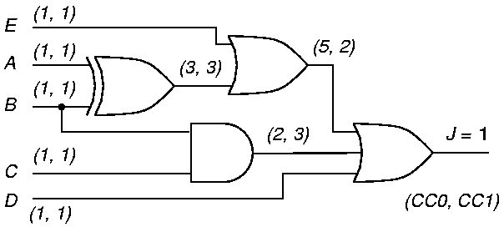
Podem Example
3. Logic simulation for A=0
2. Backtrace “A=0”
1. Objective “0”
0
S-a-1
(9, 2)
4. Objective possible but not accomplished

Slide 20
Podem Example (Cont.)
6. Logic simulation for A=0, B=0
5. Backtrace “B=0”
1. Objective “0”
0
0
0
S-a-1
0
(9, 2)
7. Objective possible but not accomplished

Slide 21
Podem Example (Cont.)
9. Logic simulation for E=0
8. Backtrace “E=0”
1. Objective “0”
0
0
0
0
0
S-a-1
0
(9, 2)
10. Objective possible but not accomplished

Slide 22
Podem Example (Cont.)
12. Logic simulation for D=0
1. Objective “0”
0
0
0
0
0
S-a-1
0
0
(9, 2)
0
13. Objective accomplished
11. Backtrace “D=0”

Slide 23
An ATPG System
Random pattern
generator
Fault simulator
yes
Fault
coverage
improved?
Random
patterns
effective?
Deterministic
ATPG (D-alg.
or Podem)
Save
patterns
yes
no
no
Stop if fault coverage goal achieved

Slide 24
Summary
Most combinational ATPG algorithms use D-algebra.
D-Algorithm is a complete algorithm:
    Finds a test, or
    Determines the fault to be redundant
    Complexity is exponential in circuit size
Podem is also a complete algorithm:
    Works on primary inputs – search space is smaller than that of D-algorithm
    Exponential complexity, but several orders faster than D-algorithm
More efficient algorithms available – FAN, Socrates, etc.
    See, M. L. Bushnell and V. D. Agrawal, Essentials of Electronic Testing for Digital, Memory and Mixed-Signal VLSI Circuits, Springer, 2000, Chapter 7.

Slide 25
Exercise 2: Lectures 4-6
For the circuit shown above
    Determine SCOAP testability measures.
    Derive a test for the stuck-at-1 fault at the output of the AND gate.
    Using the parallel fault simulation algorithm, determine which of the four primary input faults are detectable by the test derived above.

Slide 26
Exercise 2: Answers
■ SCOAP testability measures, (CC0, CC1) CO, are shown below:
(1,1) 4
(2,3) 2
(1,1) 4
(4,2) 0
(1,1) 3
(1,1) 3

Slide 27
Exercise 2: Answers Cont.
■ A test for the stuck-at-1 fault shown in the diagram is 00.
0
0
D
D
0
s-a-1

Slide 28
Exercise 2: Answers Cont.
■ Parallel fault simulation of four PI faults is illustrated below.
Fault PI2 s-a-1 is detected by the 00 test input.
0 0 1 0 0
0 0 0 0 0
PI1=0
0 0 0 0 1
0 0 0 0 1
PI2=0
0 0 0 0 1
No fault
PI1 s-a-0
PI1 s-a-1
PI2 s-a-0
PI2 s-a-1
0 0 0 0 1
PI2 s-a-1 detected

